Slide 1
COMP1860 Building our Digital World: Computer Systems & Architecture
S1.W8.L1: Designing and Implementing Sequential Logic circuits in HACK HDL
Leandro Soares Indrusiak

Slide 2


Slide 3
Last time: Program Counter

Slide 4
Objectives
Understand how to design and build sequential logic circuits
  Design a finite state machine from a functional description by:
  Drawing the state transition diagram
  Deriving a state table from the state transition diagram
  Drawing up a truth table
  Designing logic for the combinational logic unit.

Slide 5
Finite state machines
A finite state machine (FSM) is a computational model used to design and describe systems that can be in one of a finite number of states at any given time. It transitions between these states based on inputs or events.
Defined as a mathematical model consisting of:
A finite set of states – the possible conditions or configurations the system can be in.
An initial state – where the system starts.
A set of inputs – external signals or events that trigger transitions between states.
A transition function – rules that determine how the system moves from one state to another based on inputs.
Possibly a set of outputs – actions or signals produced by the machine, depending on the state or transition.

Slide 6
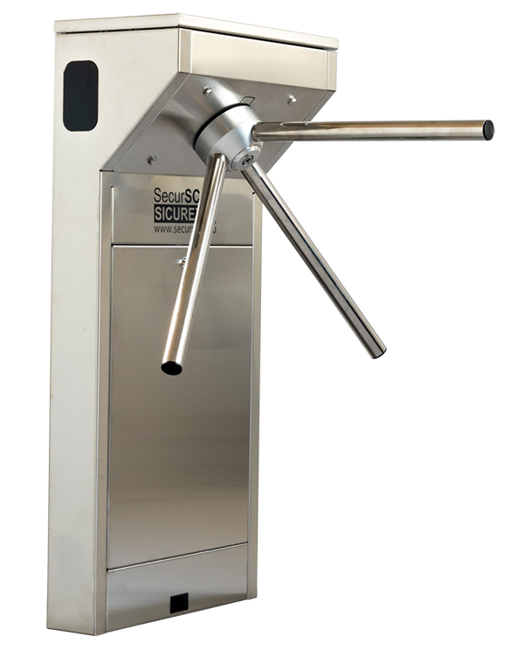
Turnstile Example
An example of a simple mechanism that can be modeled by a state machine is a turnstile.
A turnstile, used to control access to subways and amusement park rides, is a gate with three rotating arms at waist height, one across the entryway.
Initially the arms are locked, blocking the entry, preventing people from passing through.
Depositing a coin or token in a slot on the turnstile unlocks the arms, allowing a single customer to push through.
After the customer passes through, the arms are locked again until another coin is inserted.

Slide 7
Turnstile Example
The turnstile has two possible states: Locked and Unlocked.
There are two possible inputs that affect its state:
  Putting a coin in the slot (coin) and
  Pushing the arm (push).
In the locked state, pushing on the arm has no effect;
Putting a coin in shifts the state from Locked to Unlocked.
In the unlocked state, putting additional coins in has no effect;
A customer pushing through the arms resets the state to Locked.

Slide 8
Types of FSM
Deterministic FSM: For each state and input, there is exactly one transition.
Non-deterministic FSM : For a given state and input, there may be multiple possible transitions.
Mealy Machine: Outputs depend on both the current state and the input.
Moore Machine: Outputs depend only on the current state.
Example Use Cases:
  Traffic light controllers
  Vending machines
  Parsing and lexical analysis in compilers
  Game AI behaviour
  Network protocols

Slide 9
Your turn: Vending machine
Design an FSM for a Vending machine
The vending machine should:
  Accept coins (e.g., 20p, 50p, £1)
  Allow item selection after sufficient funds are inserted
  Dispense the selected item
  Return change if necessary
  Reset to initial state after transaction
Define the states, inputs, transitions, initial state, and outputs

Slide 10
Vending machine

Slide 11
Vending machine FSM

Slide 12
State-Transition Tables
The turnstile state machine can be represented by a state-transition table, showing for each possible state, the transitions between them (based upon the inputs given to the machine) and the outputs resulting from each input:
Coin | Push | Present state | Next state
0 | 0 | Un-locked | Un-locked
0 | 1 | Un-locked | Locked
1 | 0 | Un-locked | Un-locked
1 | 1 | Un-locked | Locked
0 | 0 | Locked | Locked
0 | 1 | Locked | Locked
1 | 0 | Locked | Un-locked
1 | 1 | Locked | Un-locked

Slide 13
Classical model of an FSM
Inputs
Outputs
….
Combinational
logic unit
….
….
….
Q₀
D₀
….
Q_{n}
D_{n}
Synchronisation signal

Slide 14
State-Transition Tables
For our turn stile we have two inputs (coin and push) and can describe the state of the system with just a single binary value (using a single flip-flop).
Coin | Push | Present state Q(t) | Next state Q(t+1) | D(t)
0 | 0 | Un-locked (1) | Un-locked (1) | 1
0 | 1 | Un-locked (1) | Locked (0) | 0
1 | 0 | Un-locked (1) | Un-locked (1) | 1
1 | 1 | Un-locked (1) | Locked (0) | 0
0 | 0 | Locked (0) | Locked (0) | 0
0 | 1 | Locked (0) | Locked (0) | 0
1 | 0 | Locked (0) | Un-locked (1) | 1
1 | 1 | Locked (0) | Un-locked (1) | 1
D = (Q(t) ∧ ¬C ∧ ¬P) ∨ (Q(t) ∧ C ∧ ¬P)
∨ (¬ Q(t) ∧ C ∧ ¬ P) ∨ (¬ Q(t) ∧ C ∧ P)
 |  | CP
 |  | 00 | 01 | 11 | 10
Q(t) | 0 | 0 | 0 | 1 | 1
 | 1 | 1 | 0 | 0 | 1
D₀ = (Q(t) ∧ ¬P) ∨ ( C ∧ ¬ P) ∨ (¬ Q(t) ∧ C )

Slide 15
Your turn
Using https://logic.ly/demo or pen and paper design:
Implement the turnstyle circuit
Note: Attach toggle switches to the PRE and CLR inputs then set them to ON. Attaching a 1 doesn’t seem to work.

Slide 17
Your turn: Elevator example
Your task to design and implement a controller for an elevator.
Inputs:
  Requested floor
Output:
  Current floor
  Door Open
States:
  Move Up
  Move Down
  Stationary (Doors Open)
Use a register to store the current floor of the elevator
The elevator should continue moving to the requested floor without stopping.

Slide 18
Elevator FSM

Slide 19
State-Transition Table

Slide 20
Counters
So far we have built a counter from an Adder using combinational logic.
Counters are more often a combination of combinatorial and sequential logic
Counters implement
  Increment by 1
  Set to some specified value
  Reset

Slide 21
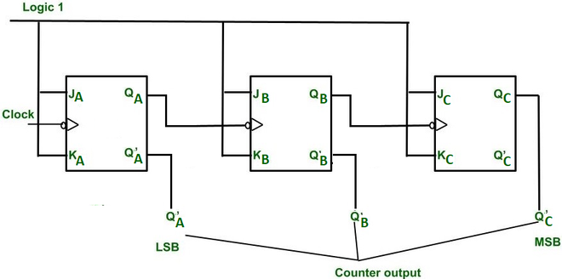
Ripple counter
A ripple counter is an asynchronous counter
  Signal to increment starts at one end and “ripples” through
J and K inputs are 1
When clock pulses counter incremented by 1
3-bit ripple counter implemented using J-K flip flops

Slide 22
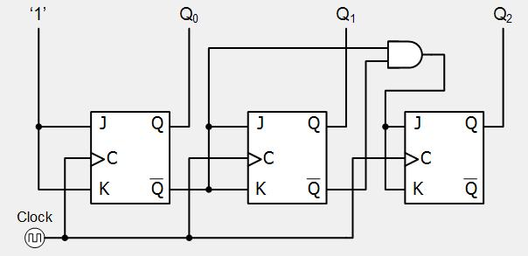
Synchronous Counter
Ripple counter
  Change “ripples” through flip flops
  Time to change proportionate to length
Synchronous counter avoids this
  Flip flops change at same time
3-bit synchronous counter

Slide 23
Your turn
Using https://logic.ly/demo or pen and paper design:
A 2-bit ripple counter
A 2-bit synchronous counter
Note: Attach toggle switches to the PRE and CLR inputs then set them to ON. Attaching a 1 doesn’t seem to work.
Hint: You don’t need an AND for a 2-bit synchronous counter

Slide 24
Answer 1

Slide 25
Answer 2

Slide 26
Summary
Introduced the concept of State Machines
Looked at state transition tables used for designing sequential circuits
Design and Implemented simple sequential circuits in HACK HDL.
Looked at the design of counters using sequential logic

